Slide 1
Armature Reaction
Lecture 5

Slide 2
Why we use Field winding and Armature winding
In a d.c. generator, the purpose of field winding is to produce magnetic field (called main flux) whereas the purpose of armature winding is to carry armature current. Although the armature winding is not provided for the purpose of producing a magnetic field, despite of that the current in the armature winding will also produce magnetic flux (called armature flux). The armature flux distorts and weakens the main flux posing problems for the proper operation of the d.c. generator. The action of armature flux on the main flux is called armature reaction

Slide 3
Armature reaction
If a load is connected to the terminals of the dc machine, a current will flow in its armature windings. This current flow will produce a magnetic field of its own, which will distort the original magnetic field from the machine’s field poles. This distortion of the magnetic flux in a machine as the load is increased is called the armature reaction.

Slide 4
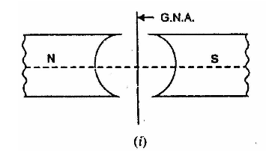
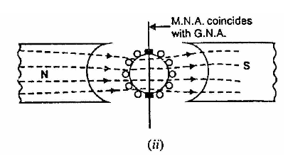
Geometrical and Magnetic Neutral Axes
(i) The geometrical neutral axis (G.N.A.) is the axis that bisects the angle between the centre line of adjacent pole.
(ii) The magnetic neutral axis (M. N. A.) is the axis drawn perpendicular to the mean direction of the flux passing through the centre of the armature. Clearly, no e.m.f. is produced in the armature conductors along this axis because then they cut no flux. With no current in the armature conductors, the M.N.A. coincides with G, N. A.
(ii). In order to achieve sparkles commutation, the brushes must lie along M.N.A.

Slide 5
Explanation
The phenomenon of armature reaction in a d.c. generator is shown in Fig. (2.1). Only one pole is shown for clarity. When the generator is on no-load, a small current flowing in the armature does not appreciably affect the main flux φ1 coming from the pole. When the generator is loaded, the current flowing through armature conductors sets up flux φ2. Fig (ii) shows flux
due to armature current alone. By superimposing φ1 and φ2 , we obtain the resulting flux φ3
as shown in Fig. (2.1) (iii). Referring to Fig (2.1) (iii), it is clear that flux density at; the trailing pole tip (point B) is increased while at the leading pole tip (point A) it is decreased. This unequal field distribution produces the following two effects:
(i) The main flux is distorted.
(ii) Due to higher flux density at pole tip B, saturation sets in.

Slide 6
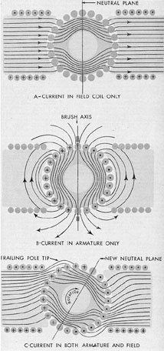
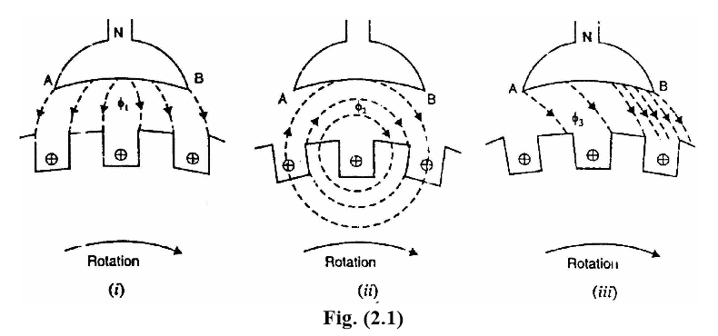

Slide 7
Armature reaction effects the normal operation of DC Generator in many ways. It actually decreases the main flux by 10% which results the generated emf to fall with the increase in load current. Thus as the load increases the armature reaction losses increases and hence the efficiency of the Generator decreases.

Slide 8
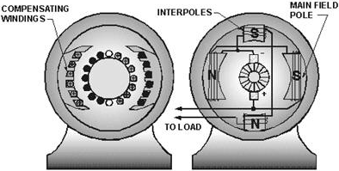
Three approaches have been developed to partially or completely correct the problems of armature reaction:
1. Brush shifting
2. Compensating windings
3. Commutating poles or inter-poles

Slide 9
BRUSH SHIFTING
Historically, the first attempts to improve the process of commutation in real dc machines started with attempts to stop the sparking at the brushes caused by the neutral-plane shifts.
there are several serious problems associated with it.
the neutral plane moves with every change in load.
the shift direction reverses when the machine goes from motor operation to generator operation.
therefore, someone had to adjust the brushes every time the load on the machine changed.,

Slide 10
ANOTHER APPROACH :-
Sometimes the brushes are fixed in a compromise position (say, one that caused no sparking at two-thirds of full load).
In this case, the motor sparked at no load and somewhat at full load.
If it spent most of its life operating at about two-thirds of full load, then sparking was minimized.
APPLICATION OF BRUSH SHIFTING:-
By about 19 10, the brush-shifting approach to controlling sparking was already obsolete.
Today, brush shifting is only used in very small machines that always run as motors.
This is done because better solutions to the problem are simply not economical in such small motors.

Slide 11
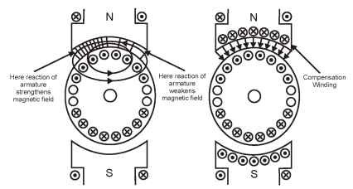
Compensating Windings
The distorting-magnetizing effect of armature reaction may cause trouble in d.c. machines subjected to large fluctuations in load. In order to neutralize the cross magnetizing effect of armature reaction, a compensating winding is used.
A compensating winding is
an auxiliary winding
embedded in slots in the
pole faces as shown in Fig.
It is connected in
series with armature in a
manner so that the
direction of current through the compensating conductors in any one pole face
will be opposite to the direction of the current through the adjacent armature
conductor

Slide 12
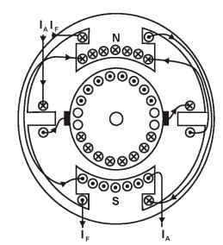

Slide 13
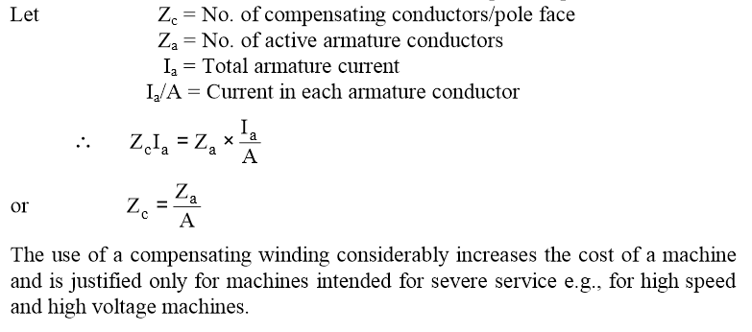
Let us now calculate the number of compensating conductors/ pole face. In calculating the conductors per pole face required for the compensating winding, it should be remembered that the current in the compensating conductors is the armature current Ia whereas the current in armature conductors is Ia/A where A is the number of parallel paths.

Slide 14
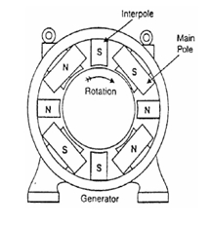
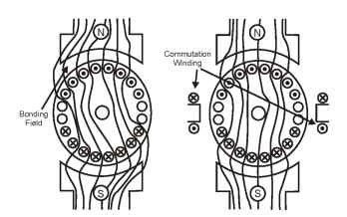
Commutating poles or inter-poles
The distortion of main field can be prevented by cancelling the effects of the flux produced by the armature current. This can be achieved by installing commutating poles in between two consecutive main poles. The commutating poles are connected in series with the armature winding, but in such a design that they cancel the effect of armature conductor flux and hence we have left only the main field flux.

Slide 15
For large machines, the commutation poles don’t completely neutralize the armature current flux because these high speed machines accept changes in their operation in matter of seconds. Thus in this case compensation windings are installed in slots of the poles faces of main field poles

