Slide 1
DC Motors
Lecture No 6

Slide 2
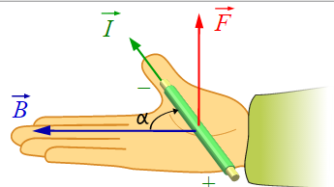
Electric and magnetic fields: Lorentz force
A current-carrying wire in a magnetic field experiences a force.
The magnitude and direction of this force depend on four variables: the magnitude and direction of the current (I), the length of the wire (L), the strength and direction of the magnetic field (B), and the angle between the field and the wire (Θ).
F = I L X B Or in scalar terms: F = I L B SinΘ
When current is in amperes, length in meters, and magnetic field in teslas, the force is in newtons.
The direction of the force is perpendicular to both the current and the magnetic field, and is predicted by the right-hand cross-product rule.

Slide 3
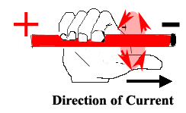
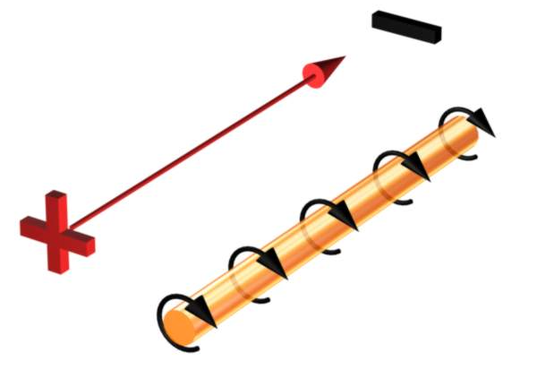
The Right Hand Rule
The direction of the magnetic field surrounding the conductor can be found using your right hand
Position the thumb of your right hand pointing in the direction of conventional current (Positive to Negative) and your fingers will wrap around the conductor in the direction of the induced magnetic field.

Slide 4
The Direction and Motion of an Induced Magnetic Field in a Conductor
X
Current Coming Towards You
Current Moving Away From You

Slide 5
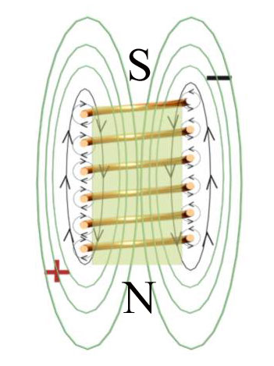
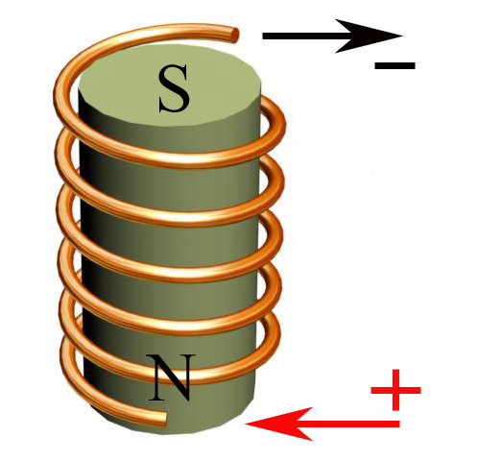
Current and Magnetism in a Coil
When current moves through a coiled conductor a circular magnetic field is induced about the coil

Slide 6
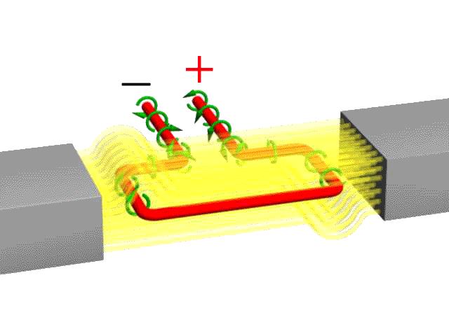
Motor (armature) rotation is caused by the simultaneous attraction and repulsion between the electromagnetic field in the armature and a fixed magnetic field
Armature
Fixed Magnets

Slide 7
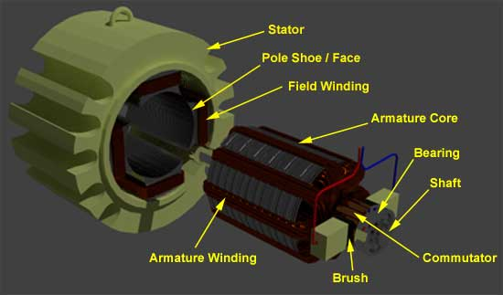
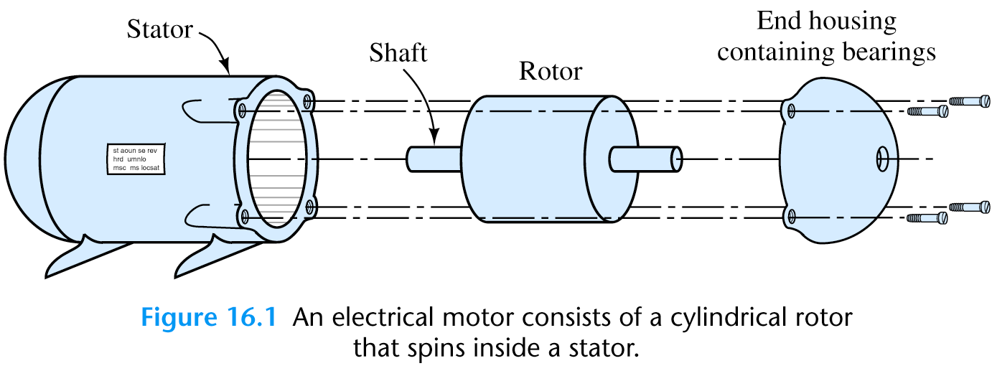
Construction of dc motor
1) Stator – The static part that houses the field windings and receives the supply and,
2) Armature – The rotating part that brings about the mechanical rotations.
3) Yoke of dc motor.
4) Poles of dc motor.
5) Field winding of dc motor.
6) Armature winding of dc motor.
7) Commutator of dc motor.
8) Brushes of dc motor.

Slide 8
D.C. Motor Principle
A machine that converts d.c. power into mechanical power is known as a d.c. motor. Its operation is based on the principle that when a current carrying conductor is placed in a magnetic field, the conductor experiences a mechanical force. The direction of this force is given by Fleming’s left hand rule and magnitude is given by;
F = BIl newtons
Basically, there is no constructional difference between a d.c. motor and a d.c. generator. The same d.c. machine can be run as a generator or motor.

Slide 9
A Conductor in a Fixed Magnetic Field
A Current Carrying Conductor in a Fixed Magnetic Field
Force
Fixed Magnetic Field
Induced Magnetic Field (Due to current)

Slide 10
A Motor Armature in a Fixed Magnetic Field
S
N
Direction of Force (Torque) acting to turn the Armature (Conductor)
The magnetic field surrounding a current carrying conductor interacts with an existing magnetic field.

Slide 11
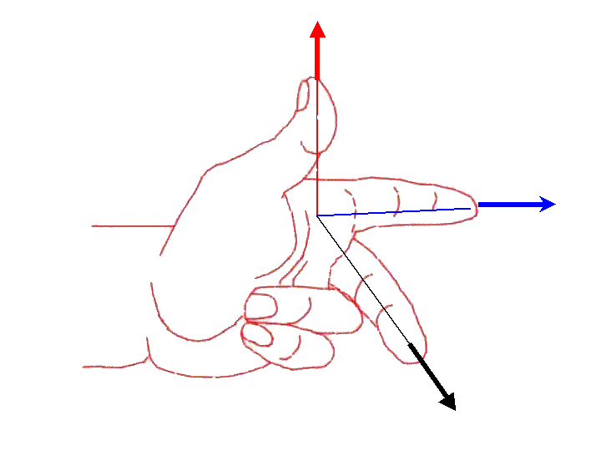
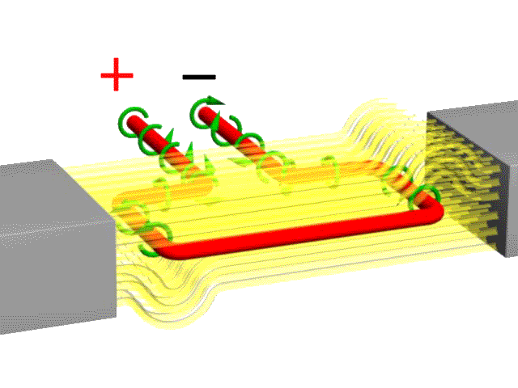
Fleming's Left Hand (Motor) Rule
Direction of Rotation
Fixed Magnetic Field Direction
Conventional Current Direction
S
N

Slide 12
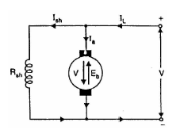
Back or Counter E.M.F.
When the armature of a d.c. motor rotates under the influence of the driving torque, the armature conductors move through the magnetic field and hence e.m.f. is induced in them as in a generator The induced e.m.f. acts in opposite direction to the applied voltage V(Lenz’s law) and in known as back or counter e.m.f. Eb. The back e.m.f. Eb(= P f ZN/60 A) is always less than the applied voltage V, although this difference is small when the motor is running under
normal conditions.
Consider a shunt wound motor. When d.c. voltage V is applied across the motor terminals, the field magnets
are excited and armature conductors are supplied with current. Therefore, driving torque acts on the armature which begins to rotate. As the armature rotates, back e.m.f. Eb is induced which opposes the applied
voltage V. The applied voltage V has to force current through the armature against the back e.m.f. Eb. The electric work done in overcoming and causing the
current to flow against Eb is converted into mechanical energy developed in the armature.

Slide 13
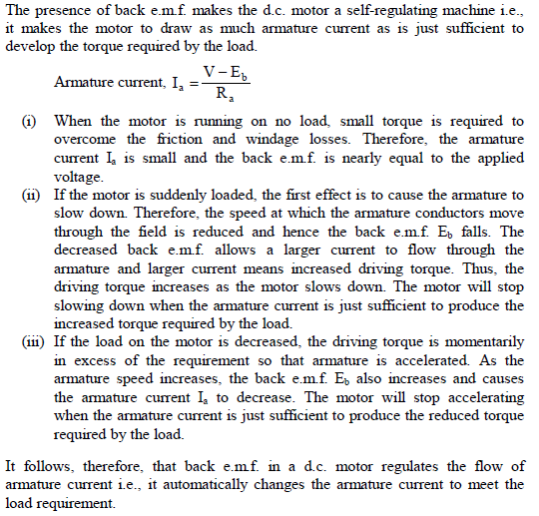
Significance of Back E.M.F.

